Slide 1














Yashaswi Finserv
Mutual Fund Distribution Website
B.Anirudh
Mithun Shet

Slide 2
CONTENTS
  Introduction
  Client Information
  Objectives
  Wireframe Design
  References

Slide 3
INTRODUCTION
This project sets up a web space where Yashaswi Finserv can display its mutual fund offerings while making advice easier to reach and building confidence through clear design. Instead of complex jargon, it uses plain layouts so users stay comfortable. Communication runs smoothly since features are built around real client-distributor chats. Simplicity drives every part, keeping things light but effective.

Slide 4
Client Information
Yashaswi Finserv operates under Pavan Tavargeri - an AMFI-certified distributor - offering clear advice on mutual funds. Located in Hubli, it emphasizes growing wealth through smart SIP strategies instead of generic plans. Tax-saving solutions come included alongside tailored financial tips built on honesty. Clients get straightforward support without hidden agendas or confusing terms.

Slide 5
Objectives
  Establish trust and credibility as an AMFI-registered mutual fund distributor.
  Generate client inquiries and investment consultations effectively.
  Educate visitors about mutual funds and guide them toward informed.

Slide 6
WIREFRAME
DESIGNS

Slide 7
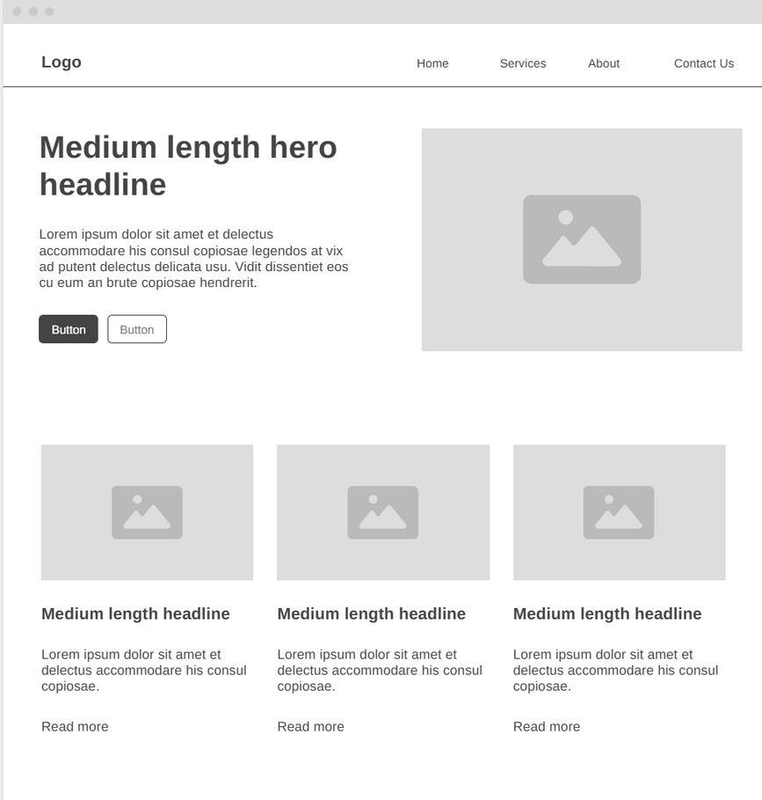
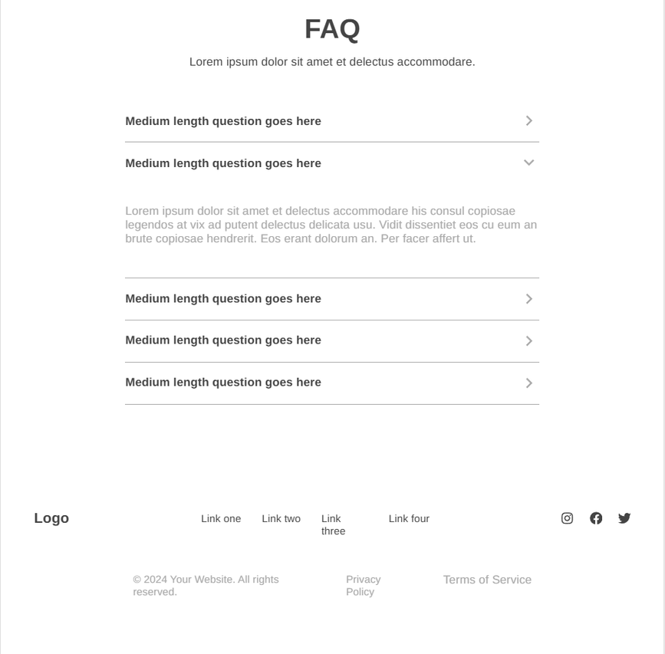
Home Page

Slide 8
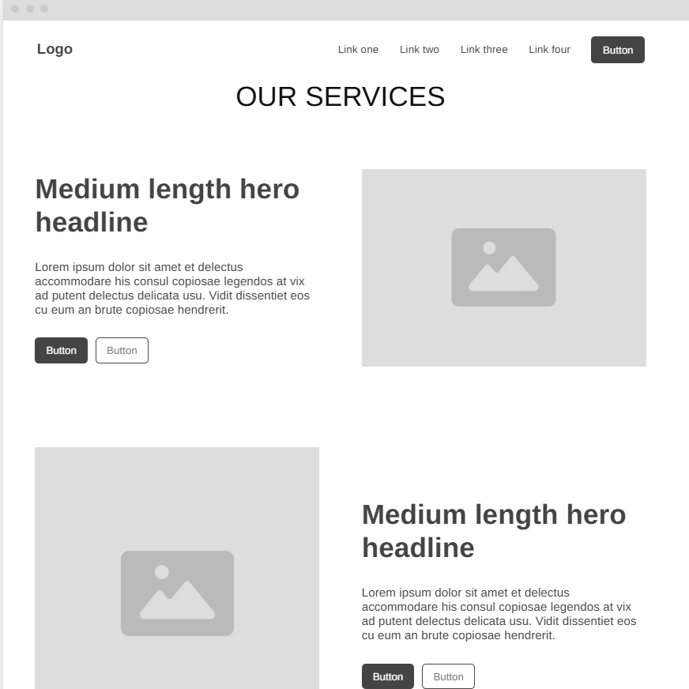
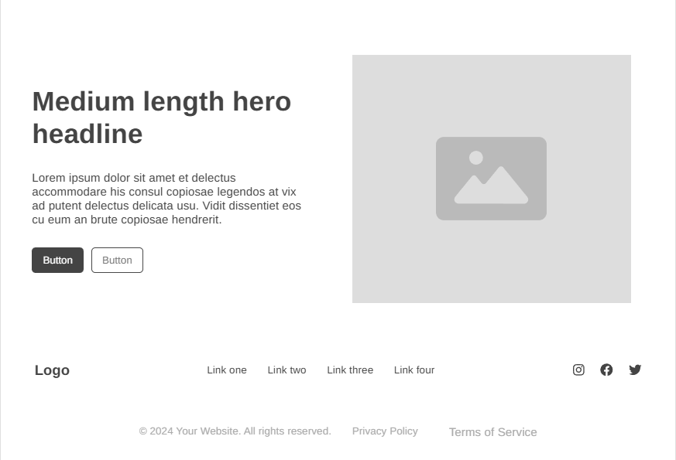
Services Page

Slide 9
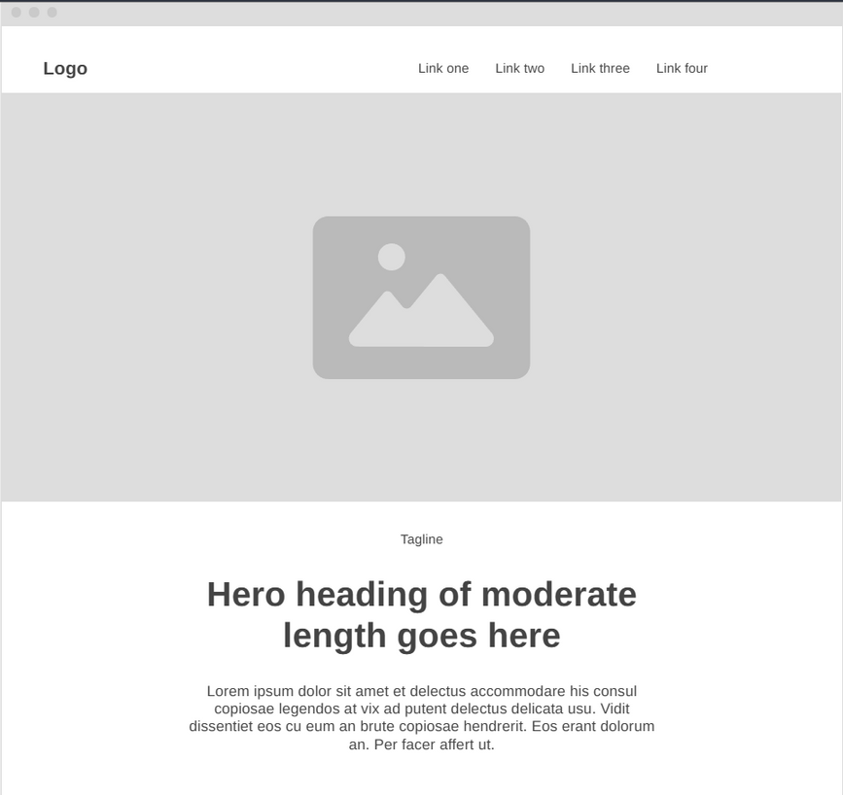
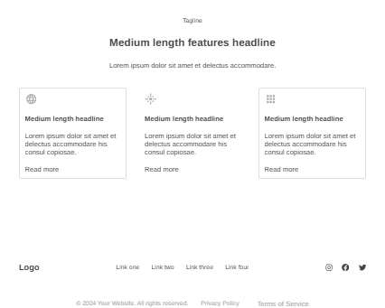
About Page

Slide 10
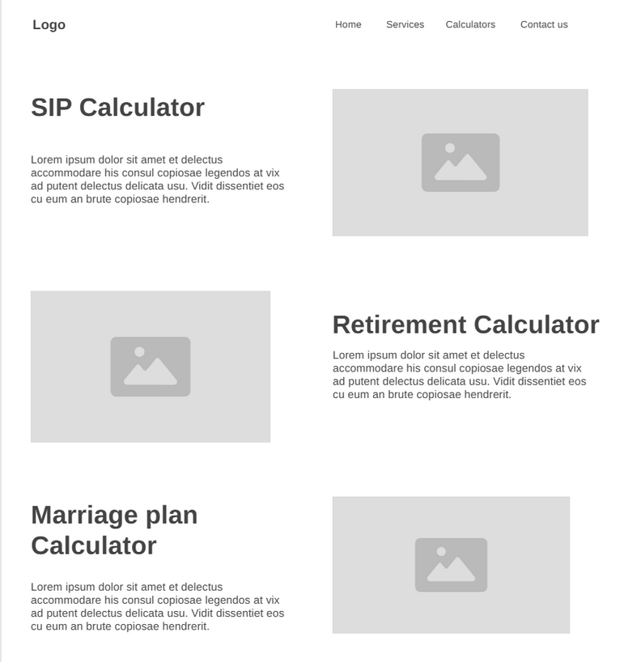
Tools/ Calculator

Slide 11
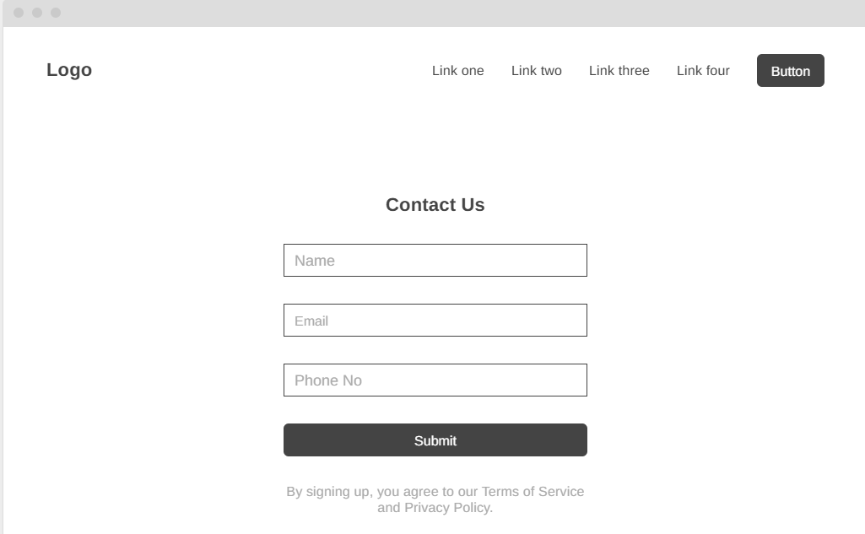
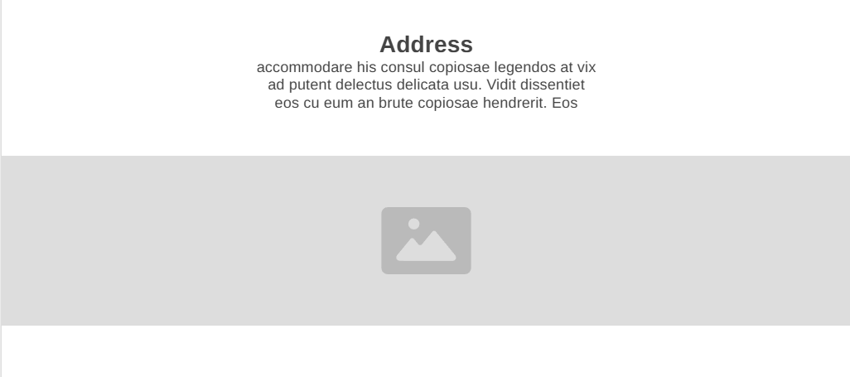
Contact Us Page

Slide 12
TECHNOLOGIES USED
  Frontend : HTML, CSS, JavaScript
  Backend: PHP
  Database: MySql

Slide 13
REFERENCES
  Lawrence lobo financial services : https://lawrencelobo.com
  Pradeep hosmani financial services : https://www.pradeephosmani.com

Slide 14
Thank you very much!

